Slide 1

Stock Reader A Web Based Stock Scanner Software
Submitted To
Asif Khan Shakir
Lecturer
Department of Software Engineering
Faculty of Science and Information Technology
Submitted By
Azmia Hoque Radhio
ID : 171-35-1932
Section: B

Slide 2
THE FOLLOWING TOPICS ARE
BACKGROUND
OBJECTIVE
GOAL
TECHNOLOGIES
DIAGRAMS

Slide 3

Background
Old Experience
Some systems are partially providing these services.
They are not complete and also not well arranged.
The current system is much vulnerable and risky.
Proposed Solution
Implement all functionalities in one system.

Slide 4
Objective:
Shareholder can add company symbols
User can View/Read real time stock market financials/statistics.
Shareholder can Filter on these statistics by different categories

Slide 5
Goal
A Shareholder may use the software to scan the stock market for various types of stock classifications (growth, momentum, value, etc.).
Stock Reader will help the Stockholder to see the real stock market statistic. As a result she/he can take decisions more wisely.

Slide 6
Technologies:
Client-side : HTML, CSS , Semantic UI and Jinja2 Templates
Server-side : Python, Fastapi, Pydantic
DBMS : SQLAlchemy
Api : yfinance
Add a footer

Slide 7
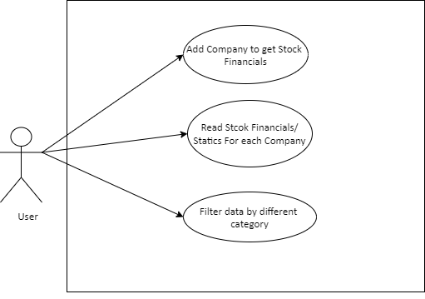
USE CASE DIAGRAM:
Add a footer

Slide 8
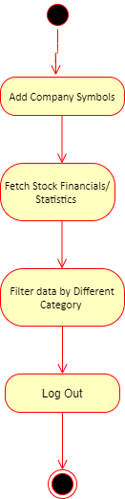
ACTIVITY DIAGRAM
Add a footer

Slide 9
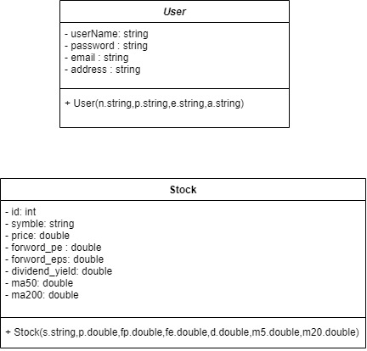
CLASS DIAGRAM
Add a footer

Slide 10
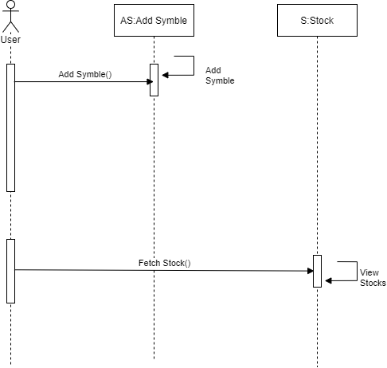
SEQUENCE DIAGRAM
Add a footer

Slide 11
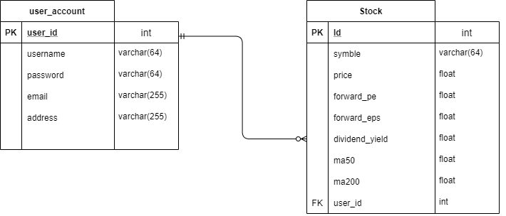
ER DIAGRAM
Add a footer

Slide 12
Thank You.
Azmia Hoque Radhio
171-35-1932
azmia35-1932@diu.edu.bd
www.radhiopy.com

